Slide 1
Effect Size, Confidence Intervals, and Diagnostic Criteria
Week 6
January 10, 2025

Slide 2
Agenda
🏠 Housekeeping
📌 Notes about the website 📌 Review sessions 📌 Final paper ❓ (Clarify expectations)
📖 Learn: Partial and Semi-Partial Correlation
📊 Example: PRAMS dataset on partial and semi-partial correlation 📊 Example: Mechanics of partial and semi-partial correlation (Annotated JASP file) 📊 Example: Graduate GPA for Multiple Linear Regression (MLR) mechanics
📖 Learn: Simple and Multiple Linear Regression (SLR & MLR) in R
📂 Data: Admissions dataset 🧠 Concept: Understanding confidence intervals & intuition about CI accuracy
✏️ Hands-on practice: Running multiple regression NSCAW I Dataset
📖 Learn: Model Assumptions
✅ Checking assumptions for regression models

Slide 3
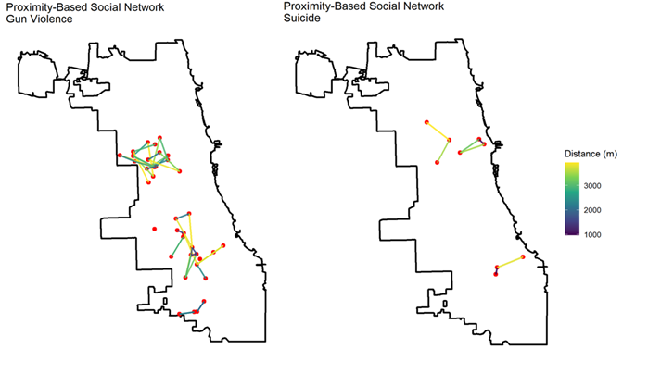
Proximity-Based Social Networks (PBSN)
Data:
Homicidal gun violence and suicides
A Chicago city boundary file (GeoJSON) is used to provide geographic context
The PBSN is built using both spatial and temporal proximity criteria:
The Haversine distance is computed between all incident pairs
Temporal proximity
Sensitivity – different thresholds used to create the networks
Remove small clusters (<=2)
Why do this?
To identify clusters of incidents that are likely socially or environmentally connected
To identify social contagion effects in suicides and homicides
Policy Implications
To inform targeted violence prevention efforts by identifying high-risk social networks.

Slide 4
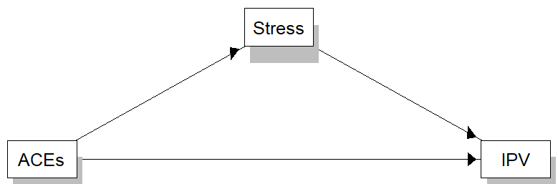
Experiences of abuse during and after pregnancy and Adverse Childhood Experiences
Measure | Odds Ratio / Risk Ratio | 95% Confidence Interval (Lower Bound) | 95% Confidence Interval (Upper Bound)
Odds Ratio for Abuse During Pregnancy (Reference: No postpartum abuse; 93.9% of total sample did not report abuse during pregnancy) | 84.165 | 79.042 | 89.62
Relative Risk for No Postpartum Abuse (Among those who experienced abuse during pregnancy: 51.4% did not experience abuse after pregnancy; 2.9% of total sample experienced abuse both during and after pregnancy) | 1.869 | 1.835 | 1.905
Relative Risk for Postpartum Abuse (Among those who experienced abuse during pregnancy: 48.6% continued experiencing abuse after pregnancy; 3.1% of total sample experienced abuse only during pregnancy) | 0.022 | 0.021 | 0.023
The odds of experiencing postpartum abuse were 84.17 times higher for individuals who had experienced abuse during pregnancy compared to those who had not (95% CI: 79.04 – 89.62, p < .001)
Conversely, the relative risk of experiencing continued postpartum abuse was 0.022, indicating that the vast majority of individuals who experienced pregnancy abuse continued to face abuse postpartum (95% CI: 0.021 – 0.023).

Slide 5
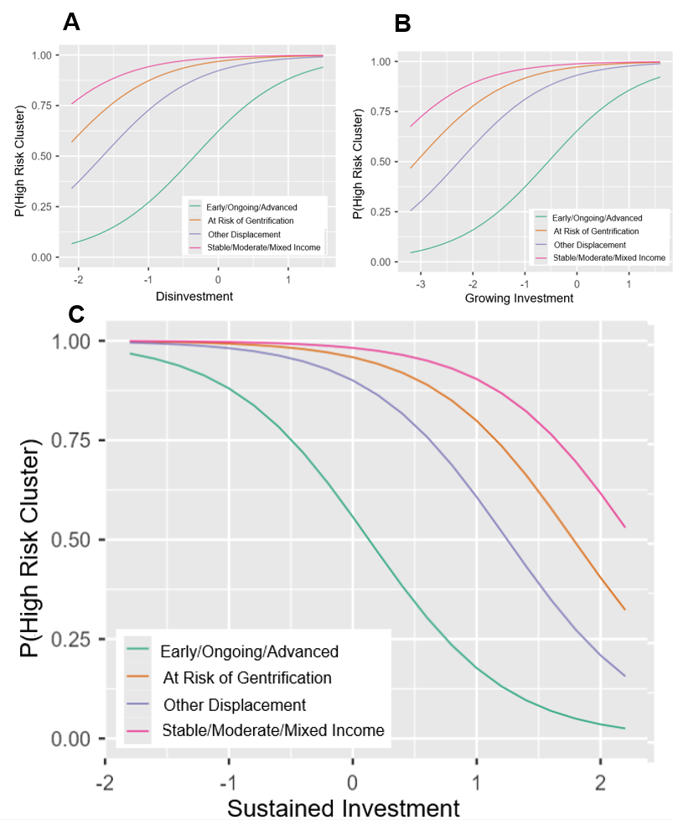
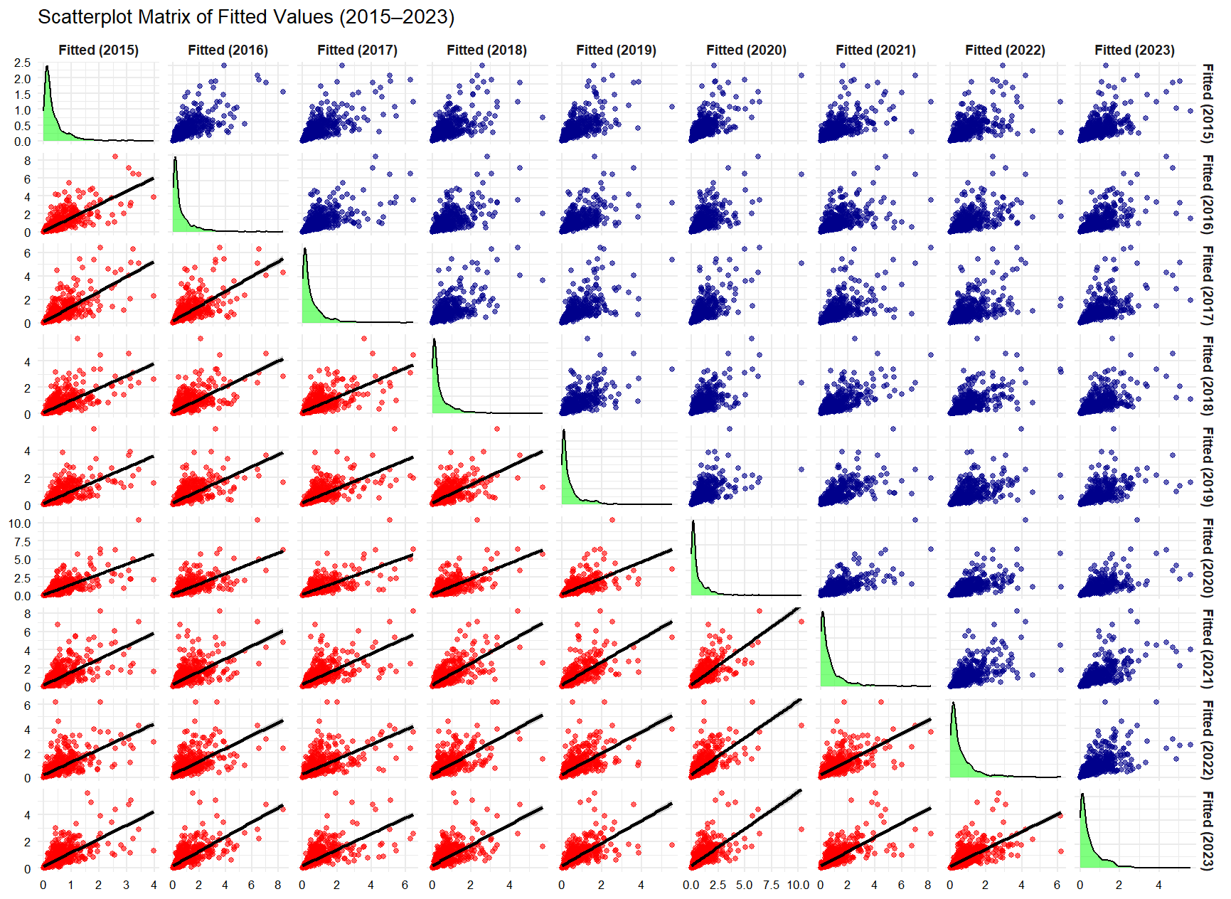
Exploring the Impact of Housing Investments and Lending Practices on Firearm Fatalities: A Bayesian Spatial Analysis of Redlining and Reverse Redlining in Chicago (2015-2023)

Slide 6
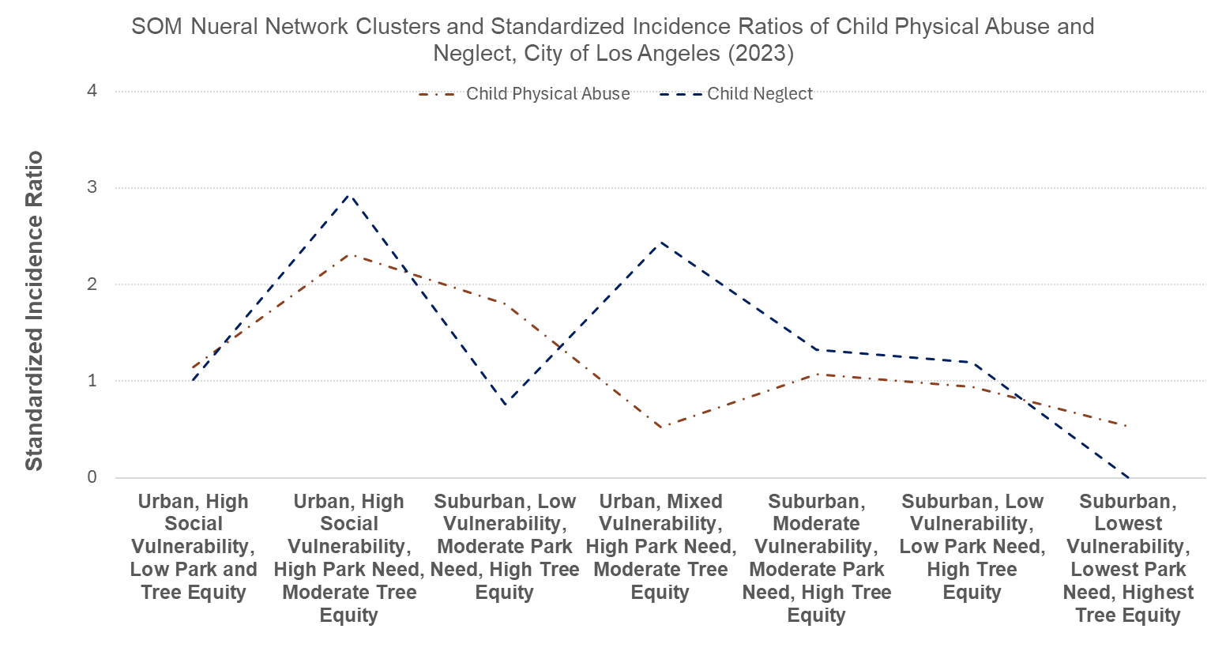
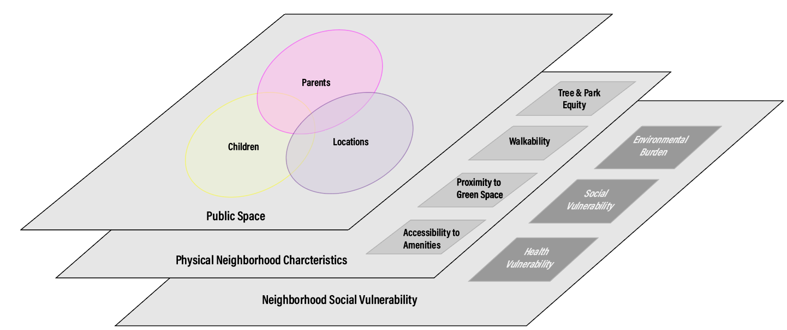
Examining nonlinear associations between the social and natural environment and child abuse and neglect using Self-Organizing Maps

Slide 7
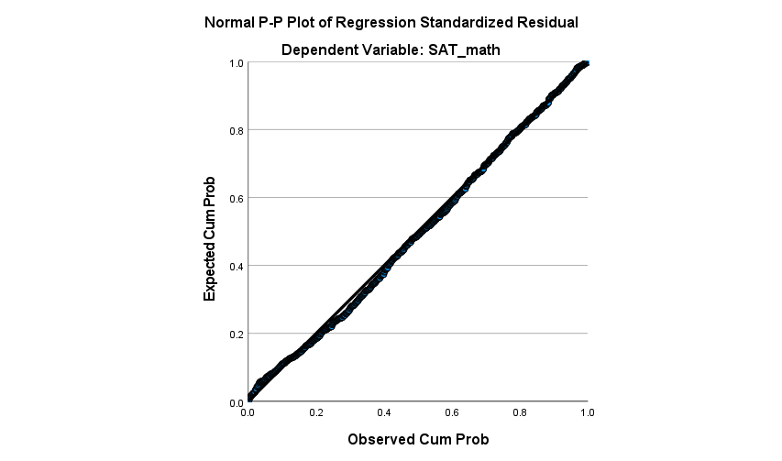
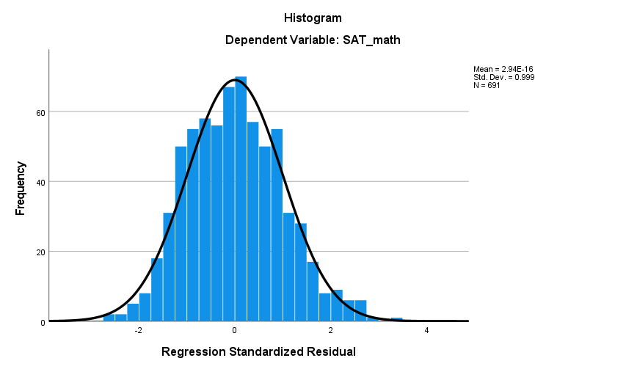
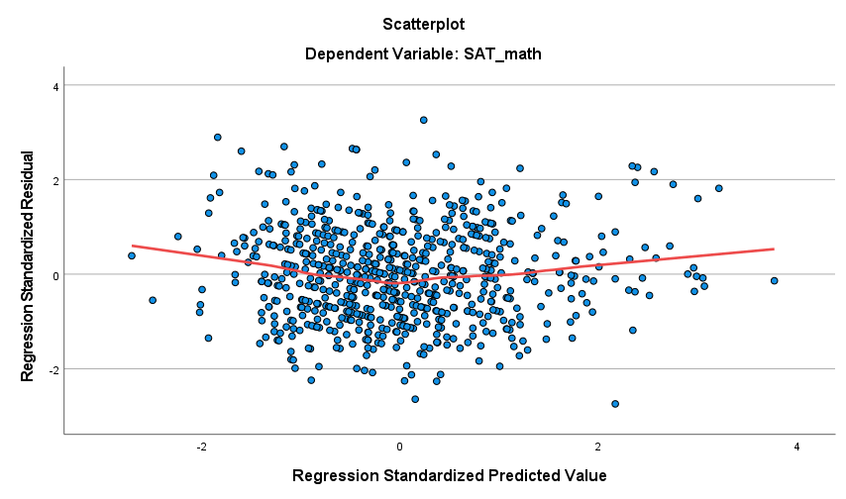
What is new…
Linear + Constant Variance – Check Residuals v Fitted
Normality of Errors – qqplot of residuals
Data is very close to line that represents a normal distribution
Normality assumption satisfied
No funnel shape (increasing variance)
Not much of a curvilinear pattern
➔ Linearity and Equal Variance assumptions are reasonably satisfied

Slide 8
We ended here
Intuition: create a plot of the standardized residuals by standardized predicted values using the admissions data ‘by hand’
Open admissions.sav

Slide 9
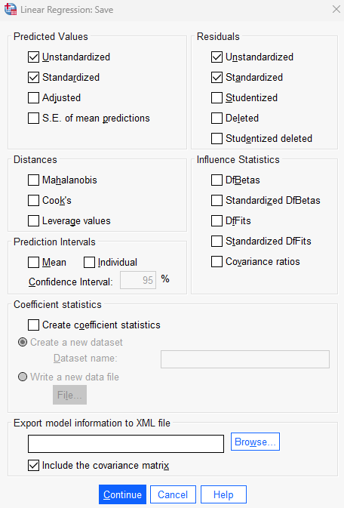
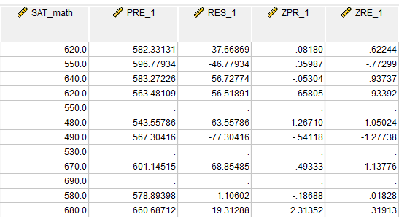
620 = 582.33131 + 37.6686

Slide 10
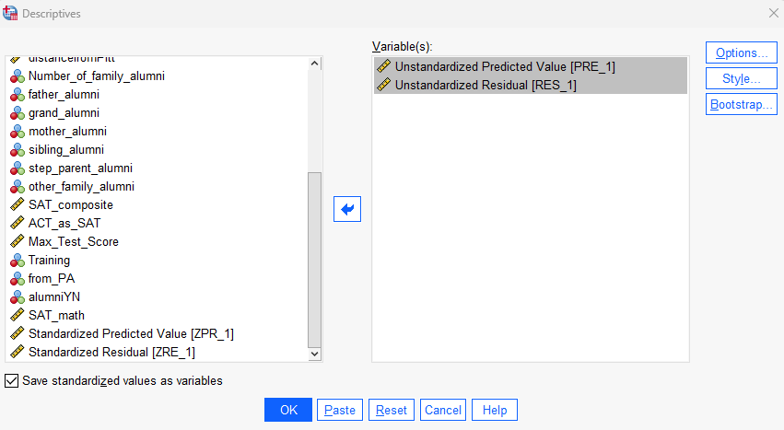
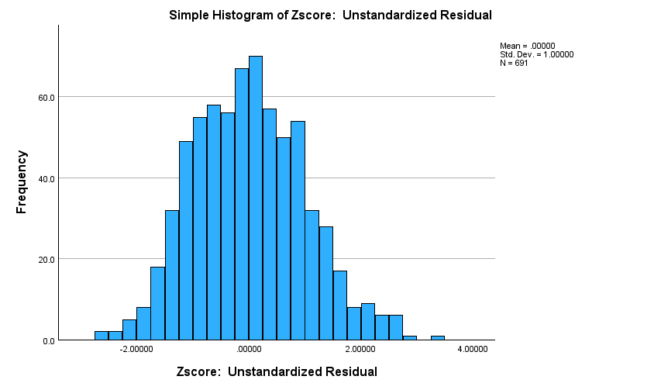
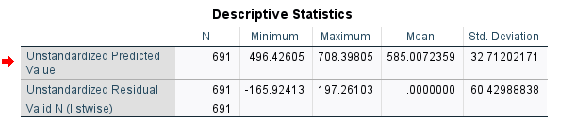



Slide 11
Effect Size: What it is, why it matters
Measure of the magnitude of a relationship or difference
Why it matters
Provides practical significance rather than just statistical significance
Helps compare results across studies (meta-analysis)(but see condom study)
Types
For mean differences (e.g., Cohen’s d)
For correlations (e.g., Pearson’s r, part and partial correlation)
For categorical data (e.g., Odds Ratio, Risk Ratio)
Interpreting guidelines
Important of context in interpretation

Slide 12
What is MLR and how does it work?
Two or more predictor (independent, control) variables and one dependent variable
Beyond one independent variable (i.e., SLR), additional variables are incorporated via partial and semipartial correlations
Partial correlation
As a three-variable example, represents the linear relationship between X₁ and Y independent of the linear influence of X₂
Semipartial (part) correlation
Linear relationship between X₁ and Y after that portion of Y that can be linearly predicted from X₂ has been removed from Y

Slide 13
Part and partial correlation in the admissions data
Partial Correlation: Measures the relationship between an independent and dependent variable after removing the influence of one or more variables on both
Example: When examining the correlation between VERBAL SAT and MATH SAT, we account for the effect of class size on both scores.
This helps isolate the true relationship between VERBAL and MATH SAT, excluding shared influence from class size
Part (Semi-Partial) Correlation: Measures the relationship between an independent and dependent variable after removing the influence of other variables only on the independent variable
Example: If we look at VERBAL SAT and MATH SAT, but only remove the effect of class size from VERBAL SAT, the correlation shows how much unique variance VERBAL SAT explains in MATH SAT, without adjusting MATH SAT for class size
This helps assess how much unique contribution class size has in explaining MATH SAT variance

Slide 14
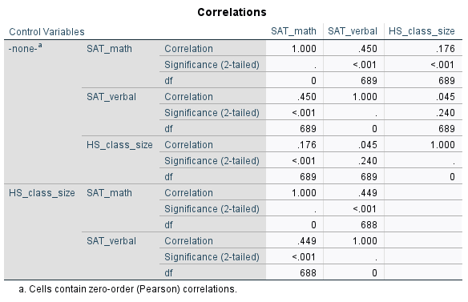


Partial correlation using the admissions example
Partial Correlation (Second Section: Controlling for HS Class Size)
Analysis: The partial correlation shows the correlation between SAT Math and SAT Verbal while controlling for HS Class Size which is r = .449, p < .001 (.450 → .449).
Interpretation: Controlling for class size has little effect on the relationship between SAT Math and SAT Verbal, meaning class size does not confound or significantly influence their correlation.

Slide 15
Partial correlation Intuition
Think of partial correlation as measuring the direct relationship between two variables (X₁ and Y) while removing the influence of a third variable (X₂) from both
Example: What is the relationship between study time and exam scores?
You find a positive correlation between them using Pearson’s r.
Another variable, X₂ may affect both variables, i.e., say IQ score (?)

Slide 16
Semipartial correlation Intuition
Think of semipartial correlation as measuring the relationship between two variables after removing the effect of a third variable from only one of them (hence semipartial)
Example:
We still want to see how study time (X₁) and exam scores (Y) are related, but we only remove the effect of IQ (X₂) from exam scores (Y)
Study time (X₁) remains unchanged.
This tells us how much study time predicts exam scores after “controlling for” the portion of exam scores that can be explained by IQ

Slide 17
Connection to MLR
Connection to Multiple Regression
In multiple linear regression, you often include multiple predictors to isolate the unique contribution of each predictor to the outcome
Partial correlation (What is the true relationship between X₁ and Y)
Partial correlation examines the relationship between two variables while statistically holding others constant—just like controlling for confounders in a regression model
"What is the relationship between X₁ and Y once the influence of X₂ has been removed from both?"
Semipartial (How much additional variance in Y does X₁ explain beyond X₂?)
In multiple regression, the semipartial correlation squared (sr²) represents the unique contribution of a predictor (X₁) to the outcome (Y) over and above other predictors.
It answers: “If I add this predictor to the model, how much additional variance does it explain?”

Slide 18
Intuition
The key difference between partial and semipartial correlation is in how they adjust for the third variable (X₃) and what they tell us about prediction
Type | What It Controls For | Meaning | Intuition
Partial Correlation | Removes the effect of X₂ from both X₁ and Y | Examines the "pure" relationship between X₁ and Y with X₂’s influence removed from both | Similar to the standardized beta coefficient (β) in multiple regression
Semipartial (Part) Correlation | Removes the effect of X₂ from only Y (or X₁) | Examines how much X₁ contributes to Y after adjusting Y for X₂, but not adjusting X₁ | Similar to the unique R² contribution of a predictor in multiple regression

Slide 19
Partial and Semi-Partial Correlation Analysis with PRAMS 8 Data

Slide 20
Your turn
Can I predict your graduate GPA based on your undergraduate GPA & score on the GRE
gregpa.sav
Process
Look at descriptive statistics
Calculate the zero order and partial correlations between the variables
Run regression analysis
Interpret coefficients
Evaluate overall model for assumptions and fit

Slide 21
GRE-GPA Example Data
Student | GRE-Total (X₁) | Undergraduate GPA (X₂) | Graduate GPA(Y)
1 | 145 | 3.2 | 4.0
2 | 120 | 3.7 | 3.9
3 | 125 | 3.6 | 3.8
4 | 130 | 2.9 | 3.7
5 | 110 | 3.5 | 3.6
6 | 100 | 3.3 | 3.5
7 | 95 | 3.0 | 3.4
8 | 115 | 2.7 | 3.3
9 | 105 | 3.1 | 3.2
10 | 90 | 2.8 | 3.1
11 | 105 | 2.4 | 3.0

Slide 22
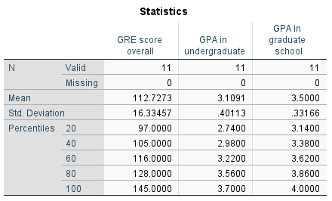
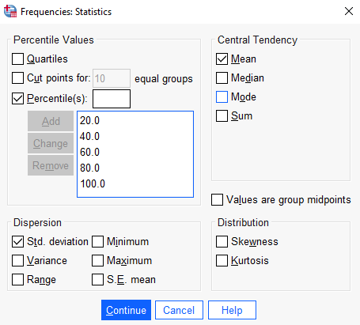
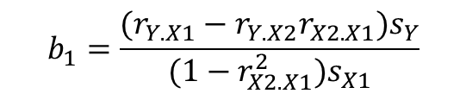
$$b_{1}=\frac{(r_{Y.X1}−r_{Y.X2}r_{X2.X1})s_{Y}}{(1−r_{X2.X1}^{2})s_{X1}}$$
Y = GPA in graduate school
X1 = GRE score
X2 = Undergraduate GPA

Slide 23
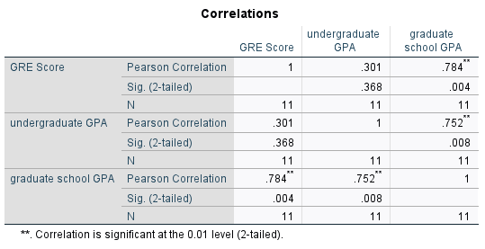
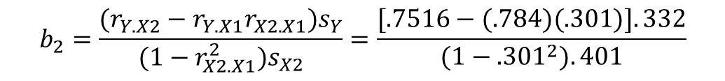
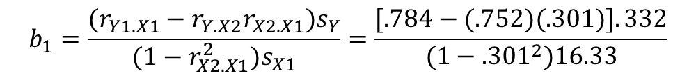



Y = GPA in graduate school
X1 = GRE score
X2 = Undergraduate GPA
Zero order (the Pearson
you already know)
$$r_{X2.X1}=.301$$
The correlation between GRE and Undergraduate GPA
$$r_{Y.X1}=.784$$
The correlation between GRE and Graduate GPA
$$r_{Y.X2}=.752$$
The correlation between Graduate GPA and Undergrad GPA
To isolate the unique effect of GRE, we subtract the portion of the GRE-Graduate GPA correlation that is explained by Undergraduate GPA
To isolate the unique effect of Undergraduate GPA we subtract the portion of the Undergraduate GPA–Graduate GPA correlation that is explained by GRE
$$b_{2}=\frac{(r_{Y.X2}−r_{Y.X1}r_{X2.X1})s_{Y}}{(1−r_{X2.X1}^{2})s_{X2}}=\frac{[.7516−(.784)(.301)].332}{(1−.301^{2}).401}$$
$$b_{1}=\frac{(r_{Y1.X1}−r_{Y.X2}r_{X2.X1})s_{Y}}{(1−r_{X2.X1}^{2})s_{X1}}=\frac{[.784−(.752)(.301)].332}{(1−.301^{2})16.33}$$
Notes:
The denominator corrects for the shared effort to get the unique contribution – this way, each predictor only gets credit for its unique effect.

Slide 24
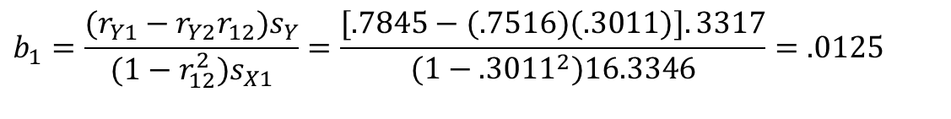
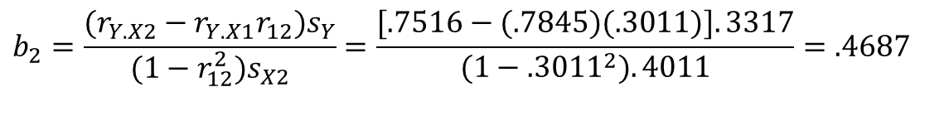
Sample Partial Slope and Intercept
After removing the shared influence of Undergraduate GPA, GRE’s unique predictive power is much lower.
GRE
$$b_{1}=\frac{(r_{Y1}−r_{Y2}r_{12})s_{Y}}{(1−r_{12}^{2})s_{X1}}=\frac{[.7845−(.7516)(.3011)].3317}{(1−.3011^{2})16.3346}=.0125$$
This effect is much stronger than GRE’s effect, indicating that Undergraduate GPA is a better predictor of Graduate GPA than GRE. Removing the influence of GRE did not reduce Undergraduate GPA’s predictive power as much as it die for GRE.
Undergraduate GPS
$$b_{2}=\frac{(r_{Y.X2}−r_{Y.X1}r_{12})s_{Y}}{(1−r_{12}^{2})s_{X2}}=\frac{[.7516−(.7845)(.3011)].3317}{(1−.3011^{2}).4011}=.4687$$
The Intercept
$$b_{0}=\bar{Y}−b_{1}{\bar{X}}_{1}−b_{2}{\bar{X}}_{2}=$$
$$3.5000−(.0125)(112.7273)−(.4687)(3.1091)=.6337$$

Slide 25

Sample Multiple Linear Regression Model
Y_{i} = $b_{0}$+ $b_{1}X_{1}+b_{2}X_{2}$+ e_{i}
$\hat{Y\text{i}}$= .6337 + .0125 X₁ + .4687 X₂ + e_{i}
If your score on the GRETOT was 130 and your UGPA was 3.5, then your predicted score on the GGPA would be computed as:
$\hat{Y\text{i}}$ = .0125 (130) + .4687 (3.5000) + .6337 = 3.8992
Admissions Data Analysis Example in R

Slide 26
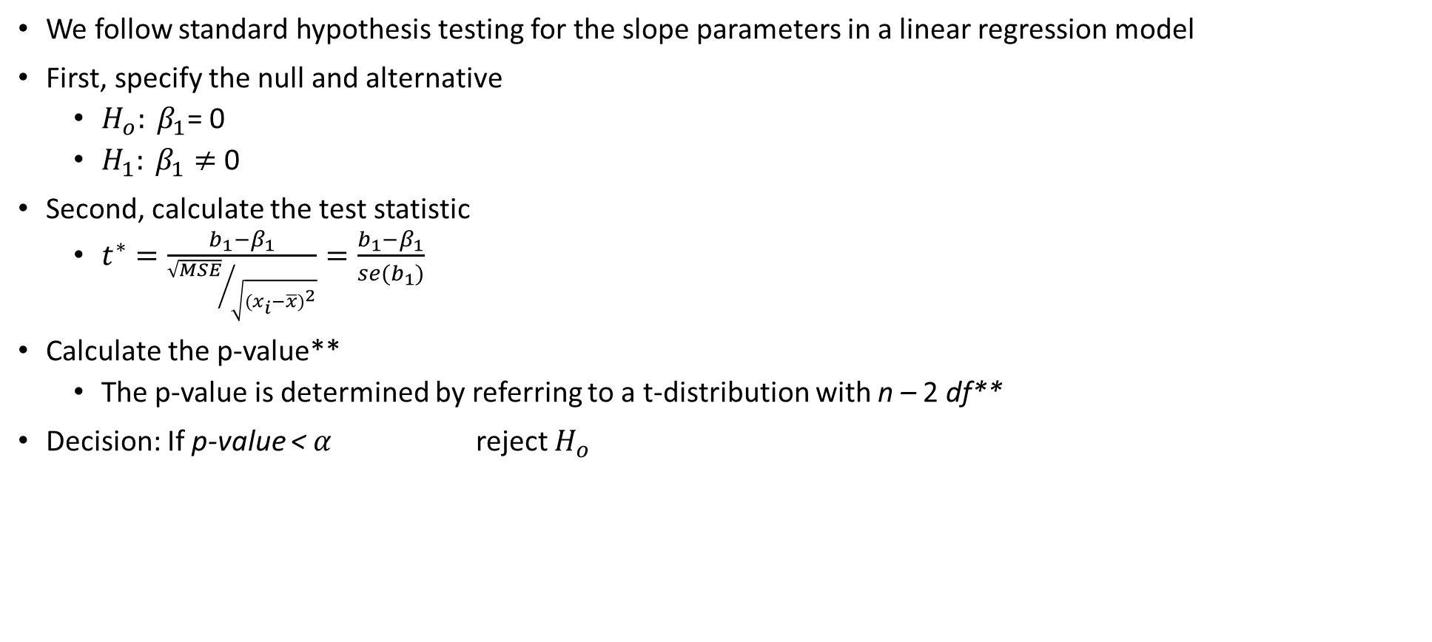
Hypothesis testing of coefficients
We follow standard hypothesis testing for the slope parameters in a linear regression model
First, specify the null and alternative
$H_{o}: β_{1}$= 0
$H_{1}: β_{1}≠$0
Second, calculate the test statistic
$t^{∗}=\frac{b_{1}−β_{1}}{{\sqrt{MSE}}/{\sqrt{{(x_{i}−\overline{x})}^{2}}}}=\frac{b_{1}−β_{1}}{se(b_{1})}$
Calculate the p-value**
The p-value is determined by referring to a t-distribution with n – 2 df**
Decision: If p-value < $α$ reject $H_{o}$

Slide 27
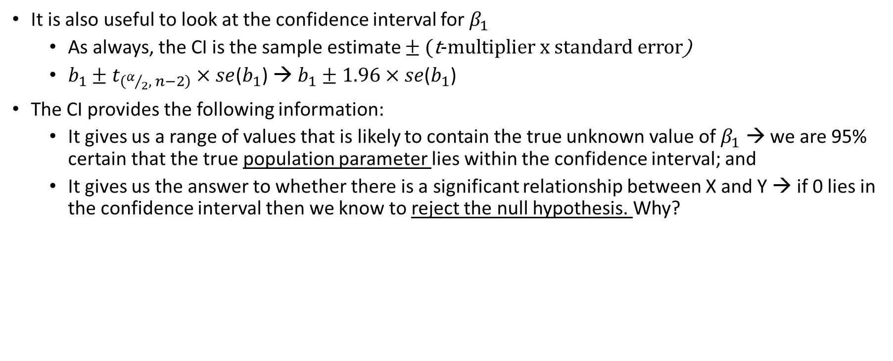
Confidence intervals as hypothesis testing
It is also useful to look at the confidence interval for $β_{1}$
As always, the CI is the sample estimate $± ($t-multiplier x standard error)
$b_{1}±t_{\left(α/2, n−2\right)}×se$($b_{1}$) → $b_{1}±1.96×se$($b_{1}$)
The CI provides the following information:
It gives us a range of values that is likely to contain the true unknown value of $β_{1}$ → we are 95% certain that the true population parameter lies within the confidence interval; and
It gives us the answer to whether there is a significant relationship between X and Y → if 0 lies in the confidence interval then we know to reject the null hypothesis. Why?

Slide 28
Inference, Error and Associations
We do not reject the null hypothesis${, H}_{o}:β_{1}$= 0
We do reject the null hypothesis${, H}_{1}:β_{1}≠ \text{0}$
We committed a Type II error
There really is not much of a linear relationship between x and y
There is a relationship between x and y — it is just not linear
We committed a Type I error.
The relationship between x and y is indeed linear.
A linear function fits the data, okay, but a curved ("curvilinear") function would fit the data even better.

Slide 29
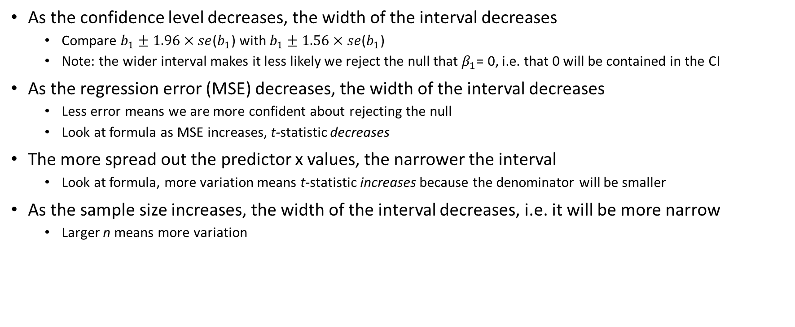
Factors affecting the width of the CI: Making the interval as narrow as possible
As the confidence level decreases, the width of the interval decreases
Compare $b_{1}±1.96×se$($b_{1}$) with $b_{1}±1.56×se$($b_{1}$)
Note: the wider interval makes it less likely we reject the null that $β_{1}$= 0, i.e. that 0 will be contained in the CI
As the regression error (MSE) decreases, the width of the interval decreases
Less error means we are more confident about rejecting the null
Look at formula as MSE increases, t-statistic decreases
The more spread out the predictor x values, the narrower the interval
Look at formula, more variation means t-statistic increases because the denominator will be smaller
As the sample size increases, the width of the interval decreases, i.e. it will be more narrow
Larger n means more variation

Slide 30
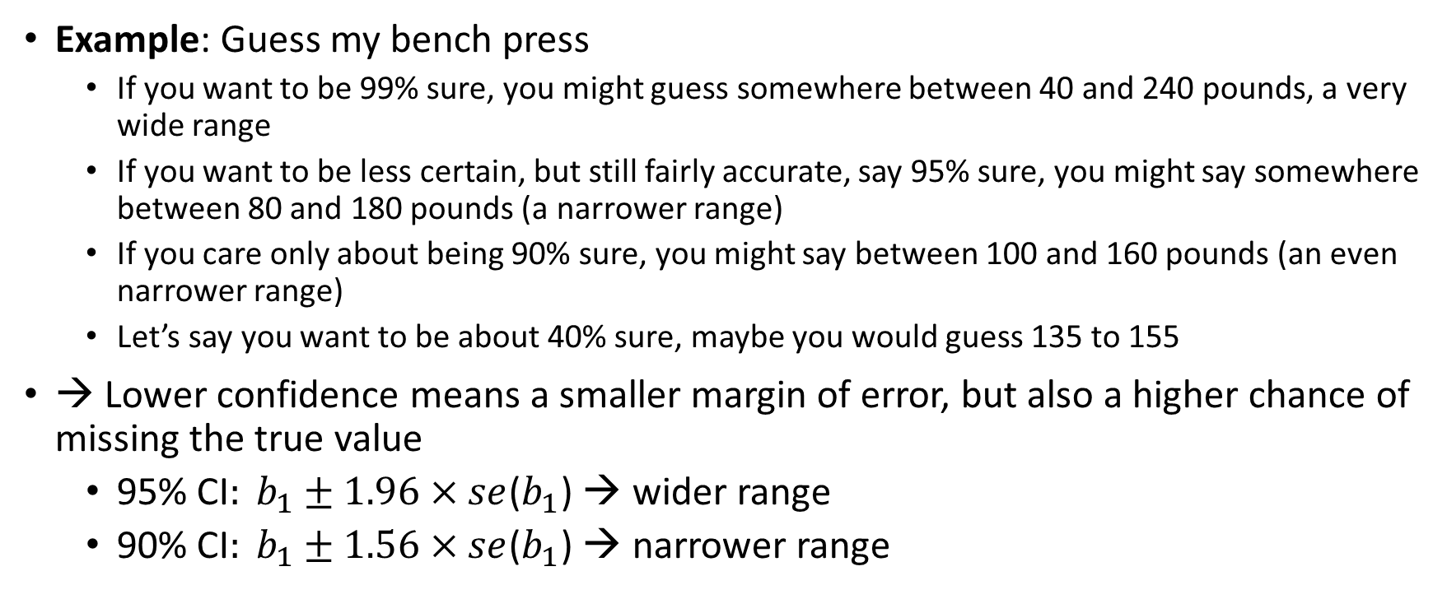
1. As the Confidence Level Decreases, the Width of the Interval Decreases
Example: Guess my bench press
If you want to be 99% sure, you might guess somewhere between 40 and 240 pounds, a very wide range
If you want to be less certain, but still fairly accurate, say 95% sure, you might say somewhere between 80 and 180 pounds (a narrower range)
If you care only about being 90% sure, you might say between 100 and 160 pounds (an even narrower range)
Let’s say you want to be about 40% sure, maybe you would guess 135 to 155
→ Lower confidence means a smaller margin of error, but also a higher chance of missing the true value
$\text{95\% }\text{CI}: b_{1}±1.96×se$($b_{1}$) → wider range
$\text{90\% }\text{CI}: b_{1}±1.56×se$($b_{1}$) → narrower range

Slide 31
2. As the Regression Error (MSE) Decreases, the Width of the Interval Decreases
Example: Predicting Commute Time to Work when I lived in Boston and Dublin
Traffic times are widely unpredictable
"I think my commute will take between 20 and 60 minutes.“
The large uncertainty in your estimate means your confidence interval is wide.
High Variability in Traffic (High MSE → Wide Confidence Interval)
Traffic times in Dublin are pretty consistent
"I think my commute will take between 28 and 32 minutes.“
Since there’s less variation in travel time, you can be more confident in your prediction, leading to a narrower confidence interval
Low Variability in Traffic (Low MSE → Narrow Confidence Interval)
Connection
If traffic is unpredictable, you give a wide range of possible commute times (like a wide confidence interval), making it harder to be certain.
If traffic is consistent, you give a narrow range, making it easier to make a firm decision (like rejecting the null)

Slide 32
3. The More Spread Out the Predictor Values, the Narrower the Interval
Example: Imagine you are measuring how study hours predict exam scores.
If everyone in the sample studies between 2-4 hours, it is hard to detect a pattern.
If some study 0 hours and others study 10+ hours, it is easier to see the effect of studying.
→ More spread in predictor values makes the estimate of b₁​ more reliable, leading to a narrower confidence interval.

Slide 33
4. As the Sample Size (𝑛) Increases, the Width of the Interval Decreases
Example: Imagine you are polling people about their favorite class
If you survey only 5 people, their responses may not represent the whole population, and history of ancient civilization may emerge the winner
If you survey 500 people, you get a more reliable estimate that statistics was their favorite class
With larger samples, the margin of error decreases because you are more confident in the results
→ Larger samples provide more precise estimates, making confidence intervals narrower.

Slide 34
Concept, Intuition, and Take-away
Concept | Intuitive Example | Key Takeaway
Lower confidence level → narrower interval | Guessing my bench—higher confidence means a wider range | Higher confidence = wider CI, lower confidence = narrower CI
Less error (MSE) → narrower interval | Commute times—more accuracy means a smaller margin of error | More precise regression estimates lead to narrower confidence intervals
More spread in X → narrower interval | Studying for an exam—more variation in study hours makes it easier to estimate impact | More predictor variation improves estimate precision
Larger sample size → narrower interval | Polling students—bigger samples reduce uncertainty | More data = smaller standard errors and narrower CIs

Slide 35
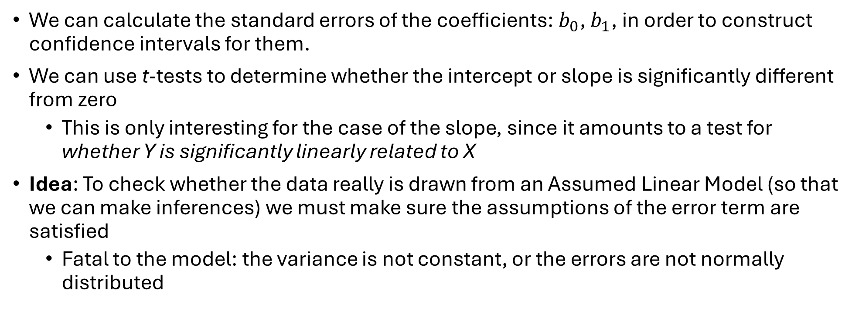
Sampling Distributions & Inference
We can calculate the standard errors of the coefficients: $b_{0}$, $b_{1}$, in order to construct confidence intervals for them.
We can use t-tests to determine whether the intercept or slope is significantly different from zero
This is only interesting for the case of the slope, since it amounts to a test for whether Y is significantly linearly related to X
Idea: To check whether the data really is drawn from an Assumed Linear Model (so that we can make inferences) we must make sure the assumptions of the error term are satisfied
Fatal to the model: the variance is not constant, or the errors are not normally distributed

Slide 36
Model Evaluation
The four conditions tell us what can go wrong
The population regression function is nonlinear
The error term is not independent
The error terms are not normally distributed
The error terms do not have equal variance
Other major issues
Presence of outliers
Bias due to an omitted variable (i.e., omitted variable bias)
Reinforce the importance of these assumptions
In OLS the tests we perform are extremely sensitive to model assumptions
Notes:
The response is not a function of linear trend plus error

Slide 37
Checking the Assumptions
We must check to see whether these assumptions are reasonable or not.
If the assumptions hold then our assumed model is correct:
Linearity → Use (standardized) Residuals vs. (Standardized) Fitted plot
Independence → Use Durbin-Watson test
Normality → Use Normal Q-Q plot
Equal Variance → Use Residuals vs. Fitted plot (aka as above)

Slide 38
Residual v Fits Plot
The bivariate plot of the predicted value against residuals can help us infer whether the relationships of the predictors to the outcome is linear and for homogeneity of variance.
The plot consists of residuals on the y-axis and fitted values on the x-axis
Here is what you are looking for:
The residuals "bounce randomly" around the residual = 0 line. This suggests that the assumption that the relationship is linear is reasonable.
The residuals roughly form a "horizontal band" around the residual = 0 line. This suggests that the variances of the error terms are equal.
No one residual "stands out" from the basic random pattern of residuals. This suggests that there are no outliers.

Slide 39
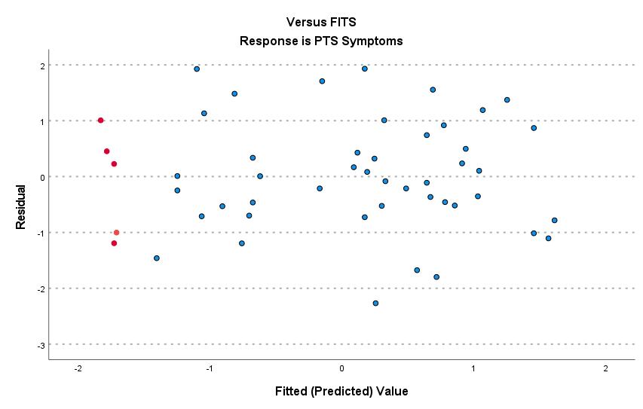
Linearity (good)
The plot suggests that there is a decreasing linear relationship between alcohol and pts . It also suggests that there are no unusual data points in the data set. And, it illustrates that the variation around the estimated regression line is constantly suggesting that the assumption of equal error variances is reasonable.
Overpredicted
Underpredicted

Slide 40
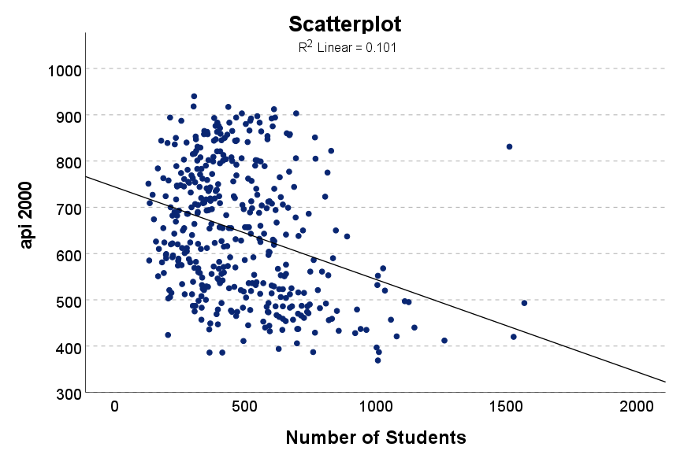
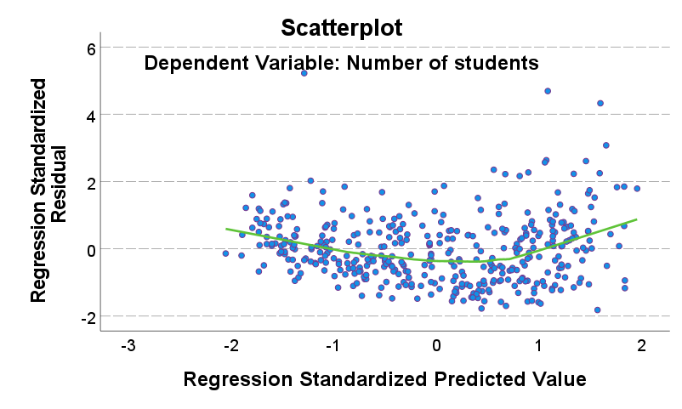
Linearity (bad) API2000 (academic performance) v Enroll (number of students)

Slide 41
Homogeneity of Variance
$$y=β_{0}+β_{1}x+ε$$
Homoscedasticity (defined): The variance of the residuals is homogeneous across levels of the predicted values
Equal variance of the distribution of the response variable for each level of the independent variable (homoscedasticity, the violation is called heteroskedasticity)
The spread of the response around the straight line is same for all levels of explanatory variable
Errors have constant variance
equal variance
non-linear (curvilinear)
increasing variance
time trend
Notes:
Three primary types of violations common in our research

Slide 42
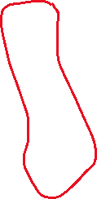

Homogeneity of Variance
If the model is well-fitted, there should be no pattern to the residuals plotted against the fitted values
If we look carefully at the plot, we see that the lower values of the standardized predicted values tend to have lower variance around zero.

Slide 43
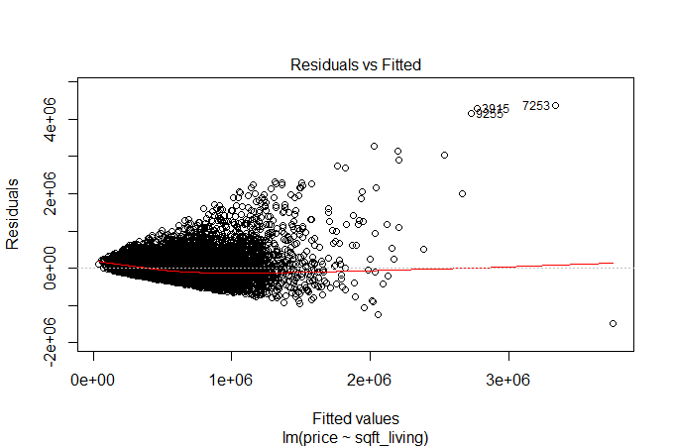
Fitted Values vs. Residuals
Looking for equal variance & linearity
Not looking for
Curvilinear
Non-constant variance
Outliers
Time trends

Slide 44
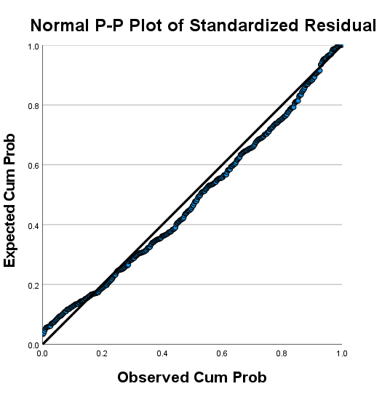
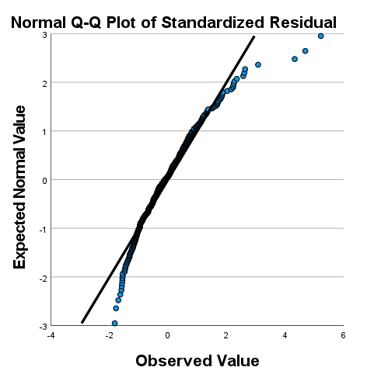
Normality of Residuals
In linear regression, a common misconception is that the outcome has to be normally distributed, but the assumption is actually that the residuals are normally distributed
A normal probability plot (P-P plot) helps us assess normality of the errors
A normal Q-Q performs the same function but SPSS does not have the option so we will create it using JASP

Slide 45
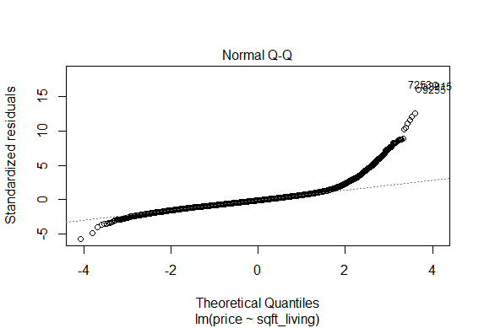
Normal Probability Plot
Looking for points to fall along dashed line (normal distribution)

Slide 46
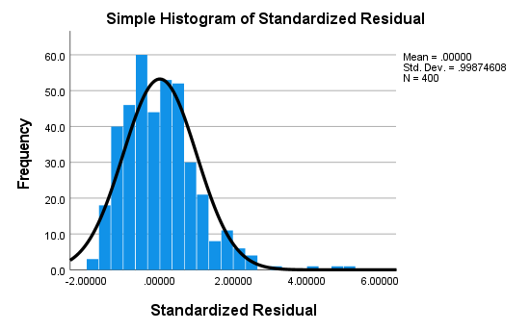
Histogram of Standardized Residuals
You can also get a sense of normality of errors by saving the standardized residuals and then creating a histogram plot with a normal overlay
This is the same result as the normal probability plot, showing a slightly right skew to the data

Slide 47
Checking for independence
Use Durbin Watson test statistic (simple)
The question is whether the residuals from the regression model are autocorrelated
Autocorrelation is the degree to which the error term of one observation is related to the error term of a different observation
The null hypothesis: the residuals are independent
Large p-value indicates the residuals are not correlated (GOOD)
Small p-value indicates the residuals are correlated (BAD)
Notes:
This is VERY common when testing model diagnostics oftentimes you DO NOT want to reject the null

Slide 48
Checking for independence
The DW statistic ranges from zero to four, with a value of 2.0 indicating zero autocorrelation
Values below 2.0 mean there is positive autocorrelation and above 2.0 indicates negative autocorrelation
Ideally, the DW should be between 1 and 3
SPSS gives the statistic only, JASP gives the value, the statistic and the p-value

Slide 49
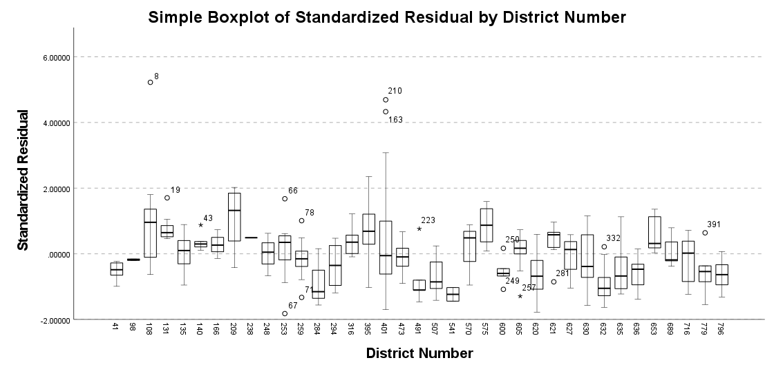
Independence of Observations
When residuals are independent, they are randomly distributed across all units. Below, if residuals were truly
independent, they would be randomly distributed across all districts. Instead, we see that some districts have
consistently positive or negative residuals. This suggests that student performance within the same district is
systematically different from others, violating independence.
Standard residuals of student performance on
Standardized tests across school districts
Notes:
Errors should not be related to any grouping factor

Slide 50
Issues of Independence
This is driven to a large degree by the method of data collection
Therefore, violations can occur in a variety of situations
Consider data on child welfare allegations in a particular state
Why might these data violate the independence assumption
If you have clustered data, you need to incorporate the clustering into your model
You can get a general sense about violations of independence via descriptive statistics

Slide 51
Note that these tests are model dependent meaning that this can change if we add more predictors. Note also that two additional model fit measures, omitted variables (model specification) and multicollinearity, are applicable to multiple linear regression

Slide 52
Multicollinearity
One of the assumptions of the linear regression model is that there is no exact linear relationship among the regressors
Perfect collinearity: A perfect linear relationship between the two variables exists.
Imperfect collinearity: The regressors are highly (but not perfectly) collinear
Multicollinearity is when the predictors in the regression equation are correlated with each other
Why care?
Even though some regression coefficients are statistically insignificant, the R² value may be very high
One may conclude (misleadingly) that the true values of these coefficients are not different from zero

Slide 53
Multicollinearity
As the number of predictors increases, multiple regression modeling can become very complicated
Example: Suppose you use both educational attainment and job type as independent variables to predict income
Educational attainment and job type are highly correlated! Thus having both educational attainment and job type in your multiple regression equation may only slightly improve the R² over an equation with just educational attainment (think semipartial correlation ☺)
Might conclude that job type is highly influential on income, while educational attainment is unimportant (or vice versa) which is not true!
Note that while there is substantial overlap between variables theoretically, they are quite distinguishable
This happened in our paper for SSRW when we included an index of redlining, concentrated disadvantage and concentrated affluence in the model
The opposite of concentrated disadvantage is not concentrated advantage
Use theory to guide the model building!!!!!

Slide 54
What to do if you find multicollinearity?
If two variables are highly correlated, it is probably not a good idea to use both in the regression equation. Why?
Many correlated variables hurts the Adjusted R²
We generally prefer smaller models
Smaller models are much easier to interpret
Multiple regression models describe the effect of one variable on another after partialling out the effects of all other variables in the model
Regarding MC, this means that if two variables are highly correlated, once one of them is partialled out, there is much less variation left in the other variable for the model to “explain”
Check the partial correlation coefficients and zero order coefficients before including variables!

Slide 55
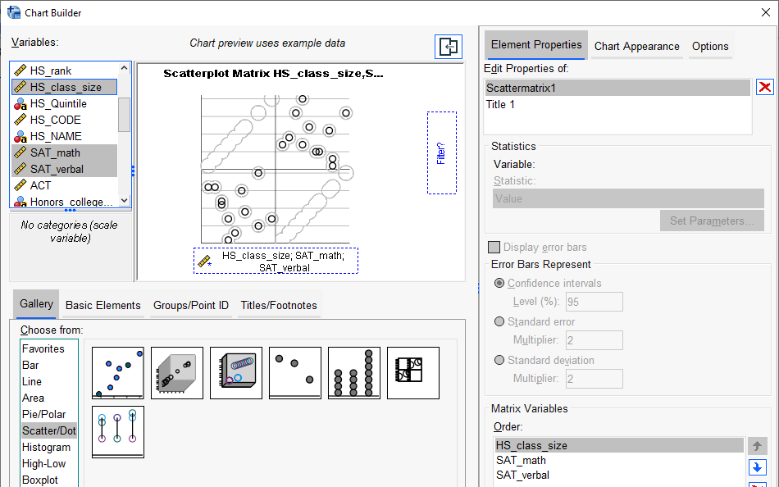
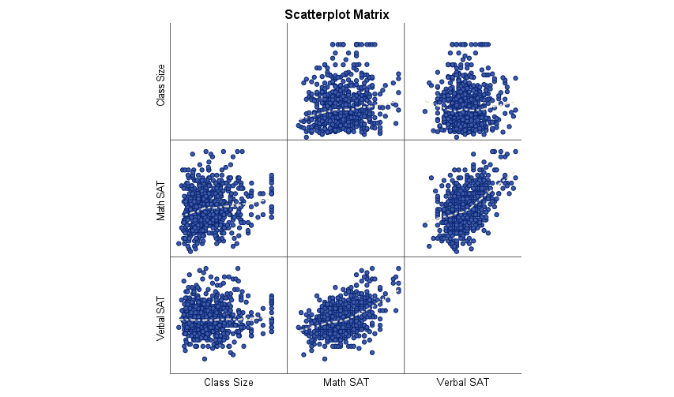
How to check for multicollinearity?
Scatterplots, Scatterplot Matrix
A scatterplot matrix is a matrix of scatterplots, one plot for each pair of variables.
Note: To read it, pick a plot in the matrix. Look in the column for the X variable and the row for the Y variable
Graph → Chart Builder → Scatter/Dot (drag variables into chart area)
GPA data.sav

Slide 56
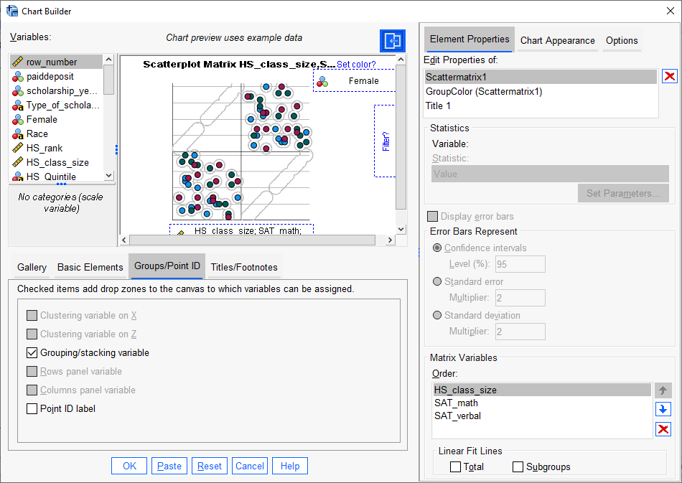
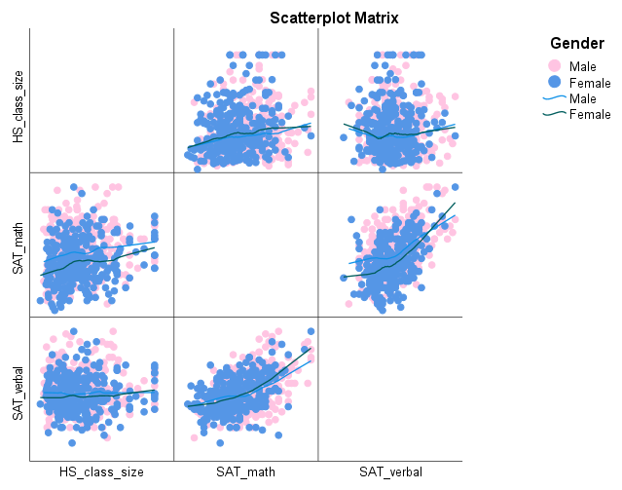
Scatterplots by Grouping Variable
Can color code a scatterplot by a categorical variable to get a sense of how the distribution of variables is heterogeneous across groups

Slide 57
Your turn
Can I predict your graduate GPA based on your undergraduate GPA & score on the GRE
Process
First, look at descriptive statistics
Second, calculate the zero order and partial correlations between the variables
Third, calculate b2 using formula
Fourth, run regression analysis
Fifth, interpret coefficients
Sixth, evaluate overall model for assumptions and fit

Slide 58
Variance Inflation Factor
$$Y_{i}=β_{0}+β_{1}X_{1i}+β_{2}X_{2i}+u_{i}$$
$$VIF=\frac{1}{1−r_{12}^{2}}$$
VIF is a measure of the degree to which the variance of the OLS estimator is inflated because of collinearity.

Slide 59
Clues that MC is a problem
High R² but few significant t ratios
High pair-wise correlations among explanatory variables or regressors
High partial correlation coefficients
High Variance Inflation Factor (VIF) and low Tolerance Factor (TOL, the inverse of VIF)

Slide 60
What should we do if we detect multicollinearity?
Nothing, for we often have no control over the data and our model is driven by theory
Redefine the model by excluding variables may attenuate the problem, provided we do not omit relevant variables
Principal components analysis (this is something we will cover later)

Slide 61
More diagnostics
An outlier is a data point whose response y does not follow the general trend of the rest of the data
It is defined as a point that is 1.5(Q3-Q1) = 1.5IQR
A data point has high leverage if it has "extreme" predictor X values
With a single predictor, an extreme x value is simply one that is particularly high or low.
With multiple predictors, extreme X values may be particularly high or low for one or more predictors
Example: r = +.90 for X₁, X₂ but a case has a high X₁ and a low value on X₂
Notes:
or may be "unusual" combinations of predictor values

Slide 62
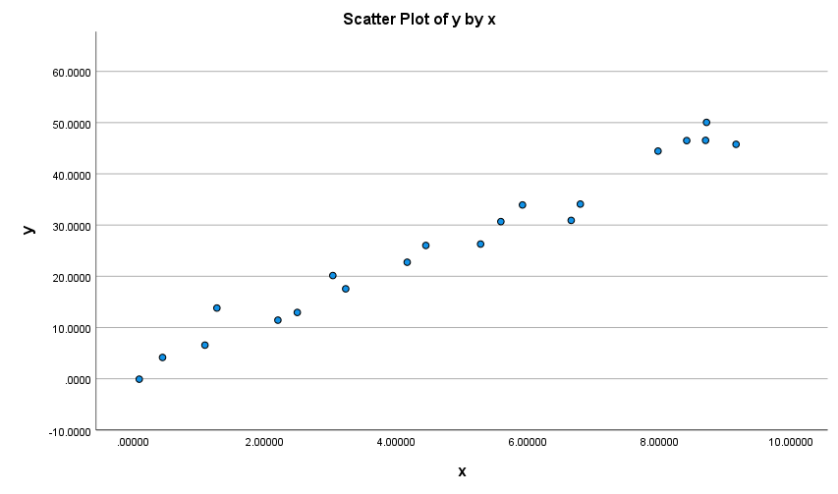

Outliers and unusual values
Does anything look unusual or different about plot A?
Does anything look unusual or different about plot B?
A
B
Notes:
The red point in B is not an extreme x value, so it does not have high leverage.
Is the red data point influential? An easy way to determine if the data point is influential is to find the best fitting line twice — once with the red data point included and once with the red data point excluded. Then note any glaring differences or inconsistencies

Slide 63
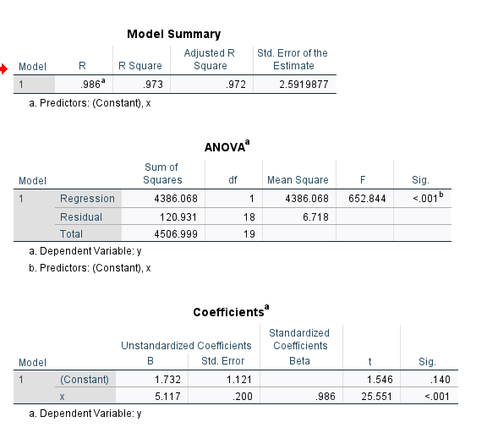
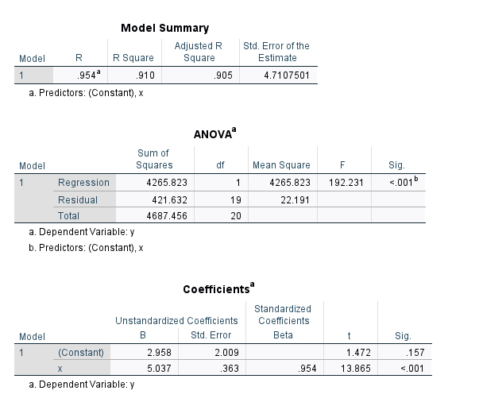
Regression output
Compare the two regressions, any differences?
A
B
Why is the standard error bigger?
Notes:
The R² value has decreased slightly, but the relationship between y and x would still be deemed strong.
The standard error of b₁, which is used in calculating our confidence interval for β₁, is larger when the red data point is included, thereby increasing the width of our confidence interval. You may recall that the standard error of b₁ depends on the mean squared error MSE, which quantifies the difference between the observed and predicted responses. It is because the red data point is an outlier — in the y direction — that the standard error of b₁ increases, not because the data point is influential in any way.
In each case, the P-value for testing H₀: β₁ = 0 is less than 0.001. In either case, we can conclude that there is sufficient evidence at the 0.05 level to conclude that, in the population, x is related to y.

Slide 64
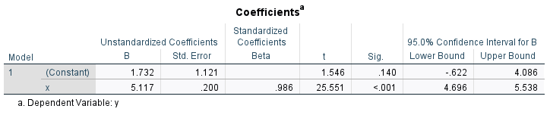

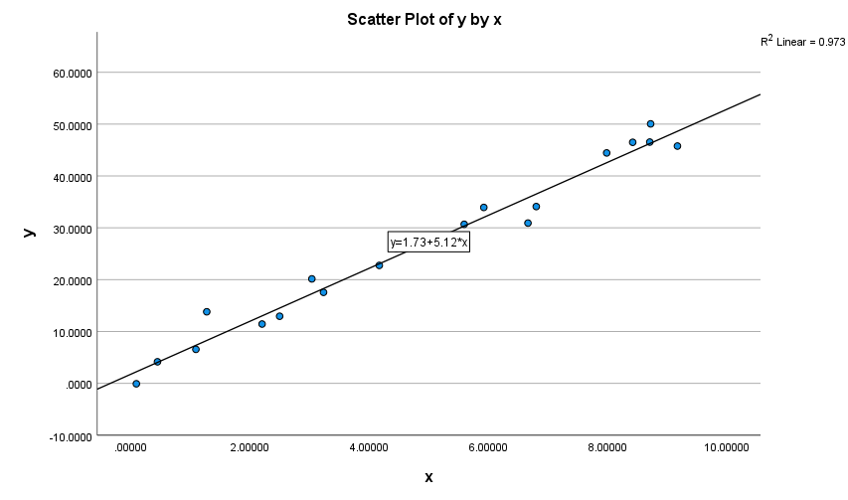
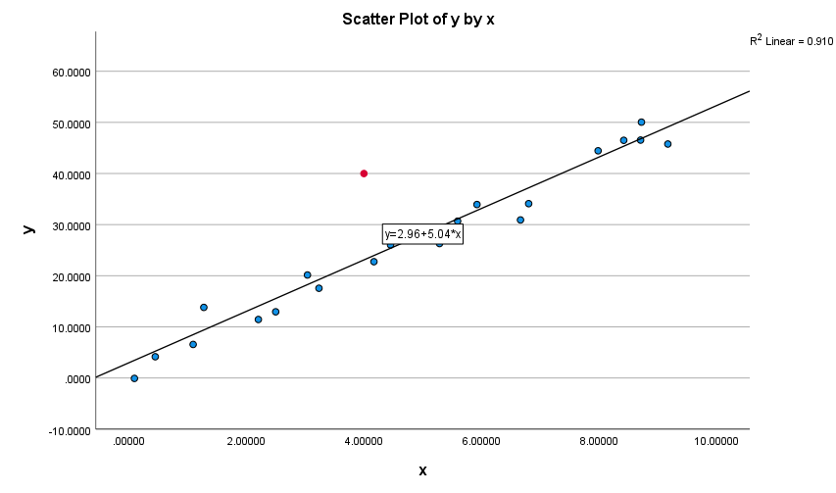
Compare & Intuit
Lines are fairly similar BUT
More error & less confidence → smaller t-value, bigger standard errors, wider confidence interval

Slide 65
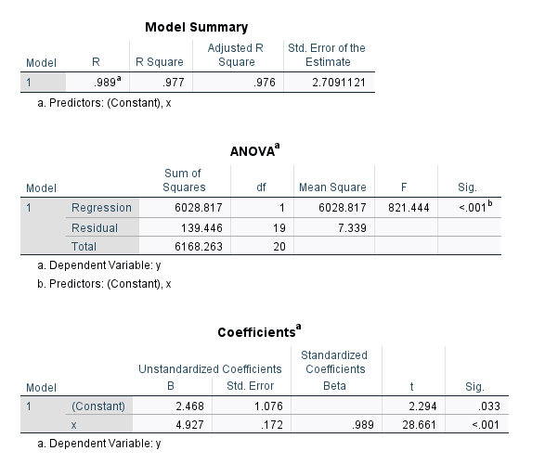

Notes:
The R² value has hardly changed at all, increasing only slightly from 97.3% to 97.7%. In either case, the relationship between y and x is deemed strong.
The standard error of b₁ is about the same in each case — 0.172 when the red data point is included, and 0.200 when the red data point is excluded. Therefore, the width of the confidence intervals for β₁ would largely remain unaffected by the existence of the red data point. You might take note that this is because the data point is not an outlier heavily impacting MSE.
In each case, the P-value for testing H₀: β₁ = 0 is less than 0.001. In either case, we can conclude that there is sufficient evidence at the 0.05 level to conclude that, in the population, x is related to y.

Slide 66



Unusual values and influential points
Does anything look unusual or different about plot A?
Does anything look unusual or different about plot B?
B

Slide 67
Identifying data points whose x values are extreme
The leverage depends only on the predictor values
The leverage suggests only that a data point potentially exerts a strong influence on the regression analysis
Whether it is influential or not in actuality depends on the observed value of the response Y_{i}
How to determine when leverage is large and worrisome?
Any observation whose leverage value, denoted h_{ii}, is > 3 times larger than the mean leverage value

Slide 68


Leverage
$$\overline{h}=\sum_{i=1}^{n}{\frac{h_{ii}}{n}}=\frac{p}{n}$$
p = # of parameters in the model and n = the number of observations
That is, if:
Then flag the observations as unusual → X is an observation whose value gives it large leverage for the regression analysis
$$h_{ii}>3\left(\frac{p}{n}\right)$$

Slide 69

Example
You perform a SLR with n = 21 cases. What is the leverage cutoff value that gives you some reason to be concerned?
p = 2, n = 21
$h_{ii}>3\left(\frac{2}{21}\right)$=.286

Slide 70


Can have SPSS provide outliers

Slide 71


Recall the mean leverage is p/n. If all the observations have roughly equivalent influence on the estimated value of the coefficients, the leverages would be close to

Slide 72



Notes:
The R² value has decreased substantially from 97.32% to 55.19%.
The standard error of b₁ is almost 3.5 times larger when the red data point is included — increasing from 0.200 to 0.686. This increase would have a substantial effect on the width of our confidence interval for β₁
the t-statistic decreases dramatically from 25.55 to 4.84 but is still statistically significant

Slide 73
Example - Pharmacodynamics of LSD
Math Score (y) | LSD Conc (x)
78.93 | 1.17
58.20 | 2.97
67.47 | 3.26
37.47 | 4.69
45.65 | 5.83
32.92 | 6.00
29.97 | 6.41
Response (Y) - Math score (mean among 5 volunteers)
Predictor (X) - LSD tissue concentration (mean of 5 volunteers)
Make scatterplot of data in SPSS
USE LSD.SAV – a made up example of LSD concentration in blood and math score on a test

Slide 74


From SPSS

Slide 75


From SPSS
Put score on Y axis and LSD on X axis
Before we customize the plot it will look like this
Let’s take some time making the chart look prettier

Slide 76

Revised Scatterplot
As LSD concentration increases, math score decreases
Looks like a strong, linear relationship
Let’s do a SLR to get the nature of the relationship

Slide 77

Least Squares Computations
$S_{xx}=\sum{{(X−\overline{X})}^{2}}$
$S_{yy}=\sum{{(Y−\overline{Y})}^{2}}$
$S_{xy}=\sum{{(X−\overline{X})(Y−\overline{Y}) }^{ }}$
$b_{1}=\frac{\sum{{(X−\overline{X})(Y−\overline{Y}) }^{ }}}{\sum{{(X−\overline{X})}^{2}}}$=$\frac{S_{xy}}{S_{xx}}$
$b_{0}=$ $\overline{Y}$ ${−b}_{1}\overline{X}$
$s^{2}$ =$\frac{\sum{{(Y−\hat{Y})}^{2}}}{n−2}$ = $\frac{SSE}{n−2}$

Slide 78


Example -Pharmacodynamics of LSD
Score (Y) | LSD Conc (X) | $$X−\overline{X}$$ | $$Y−\overline{Y}$$ | $$S_{xx}$$ | $$S_{xy}$$ | $$S_{yy}$$
78.93 | 1.17 | -3.16 | 28.84 | 10.00 | -91.23 | 831.92
58.20 | 2.97 | -1.36 | 8.11 | 1.86 | -11.06 | 65.82
67.47 | 3.26 | -1.07 | 17.38 | 1.15 | -18.65 | 302.17
37.47 | 4.69 | 0.36 | -12.62 | 0.13 | -4.50 | 159.19
45.65 | 5.83 | 1.50 | -4.44 | 2.24 | -6.64 | 19.69
32.92 | 6.00 | 1.67 | -17.17 | 2.78 | -28.62 | 294.71
29.97 | 6.41 | 2.08 | -20.12 | 4.31 | -41.78 | 404.69
350.61 | 30.33 | 0.00 | 0.00 | 22.47 | -202.49 | 2078.18
Column totals are in red
Verify
$\overline{Y}$ = 50.087
$\overline{X}$ = 4.333
$b_{1}$= -202.49/ 22.47=-9.01
$b_{0}=$ 50.09 – (-9.01 x 4.33) = 89.10
$\hat{Y}$= 89.10-9.01X
$s^{2}$ = 50.72
Let’s do it in SPSS

Slide 79




Slide 80



$$Score=89.125 −9.009LSD$$

Slide 81


Example -Pharmacodynamics of LSD
$H_{o}: β_{1}$= 0 vs $H_{1}: β_{1}≠$0
n = 7; ${ b}_{1}$= -9.01; $s=\sqrt{50.72}=7.12;$ Sxx – 22.475; se($b_{1}$) = 7.12/22.475 = 1.50
Testing
t* = -9.01 / 1.50 = -6.01 → p = .002 → reject Null
Note, the t equals the Z only when N is large

Slide 82



Example -Pharmacodynamics of LSD
n = 7
$b_{1}$=-9.01
se($b_{1}$) = 7.12/22.475 = 1.50
95% CI
-9.01 $±$ 2.57(1.50) → -9.01$±3.86$ → (-12.87, -5.15)
From this confidence interval, do you reject the Null?

Slide 83


Example
$$S_{xx}=22.475 S_{xy}=−202.487 S_{yy}=2078.183 SSE=253.89$$
$$r=\frac{−202.487}{\sqrt{(22.475)(2078.183)}}=−0.94$$
$$R^{2}=\frac{2078.183−253.89}{2078.183}=0.88=(−0.94)^{2}$$
$R^{2}×100$ =
% of variation in the dependent variable explained by the independent variable(s) in the mode

Slide 84



Example

Slide 85
ANOVA F-test
Analysis of Variance F-test
Tests the significance of the overall model including ALL independent variables
For SLR, the F-test is the same as the t-test for b1
F = t²
Source of Variation | Sum of Squares | Degrees of Freedom | Mean Square | F
Model | SSR | 1 | MSR = SSR/1 | F = MSR/MSE
Error | SSE | n-2 | MSE = SSE/(n-2)
Total | S_{yy} | n-1

Slide 86

ANOVA F-test for SLR
Analysis of Variance F-test
$H_{o}: β_{1}$= 0
$H_{1}: β_{1}≠$0
F* = $\frac{MSR}{MSE}$ > $F_{α, df=1, n−2}$→ reject null
Source of Variation | Sum of Squares | Degrees of Freedom | Mean Square | F
Model | SSR | 1 | MSR = SSR/1 | F = MSR/MSE
Error | SSE | n-2 | MSE = SSE/(n-2)
Total | S_{yy} | n-1

Slide 87
Example - Pharmacodynamics of LSD
Total Sum of squares:
Error Sum of squares:
Model Sum of Squares:

Slide 88


Example - Pharmacodynamics of LSD
Source of Variation | Sum of Squares | Degrees of Freedom | Mean Square | F
Model | 1824.293 | 1 | 1824.293 | 35.93
Error | 253.890 | 5 | 50.778
Total | 2078.183 | 6
Analysis of Variance - F-test
H₀: all betas equal 0 vs H_{A}: at least one beta is 0
H₀: β₁ = 0 vs H_{A}: β₁ ≠ 0
$F=\frac{MSR}{MSE}=35.928>F_{α, df=1, n−2}$ = 6.61→
Reject Null

Slide 89




Fitted Values & Residuals
Fitted values for the sample cases are obtained by substituting the appropriate X values into the estimated regression function.
The residual is the difference between the observed value Yi and the fitted value ${\hat{Y}}_{i}$. The residual is denoted by $e_{i}$and is defined as
For the case above
Score (Y) | LSD Conc (X)
78.93 | 1.17
58.20 | 2.97
67.47 | 3.26
37.47 | 4.69
45.65 | 5.83
32.92 | 6.00
29.97 | 6.41
350.61 | 30.33
$Score=89.125 −9.009(4.69$)=46.87279
$e_{i}$= $Y_{i}{−\hat{ Y}}_{i}$
$e_{4}$= $Y_{4}{−\hat{ Y}}_{4}=37.47$- 46.87 = -9.4

